Slide 1
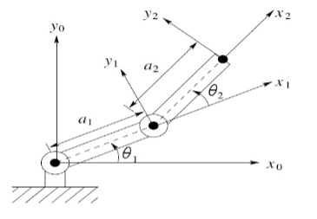
2 DoF Robot

Slide 2
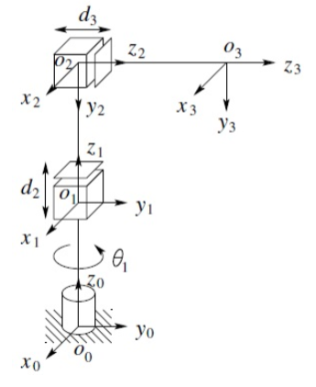
3 DoF Robot

Slide 3
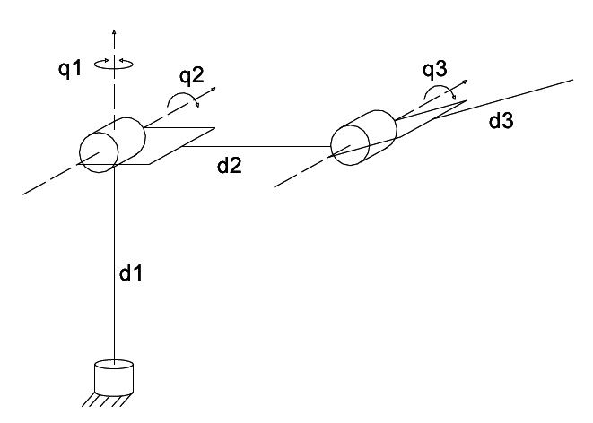
Unlabeled 3 DoF Robot

Slide 4
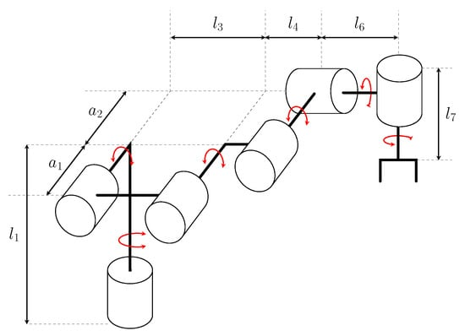
Unlabeled 6 DoF Robot

